Slide 1
Concepts J3P2
Door: Guy van der Meulen

Slide 2
Inleiding
Concept 1. “Building Blacksmith”
Concept 2. “My mine, our cavern”
Einde

Slide 3
Concept 1 “Building Blacksmith”
Main Character is a Miner/Blacksmith
3D
Building mechanics Focussed
Expand house by creating rooms
- Types of rooms (Workshop, Smelting Room, Loom Room, Heavy Workshop)
- Upgrade rooms
Third-Person player
Day/Night system (Mobs spawn during night)
Gather minerals
EXTRA: Local Multiplayer??? *(Denk te hoog gericht persoonlijk met al deze mechanics erbij….)

Slide 4
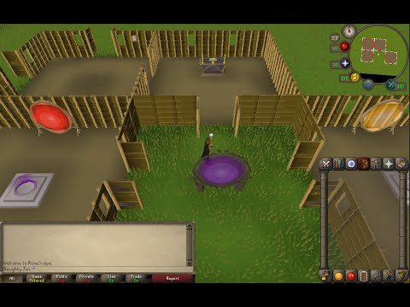
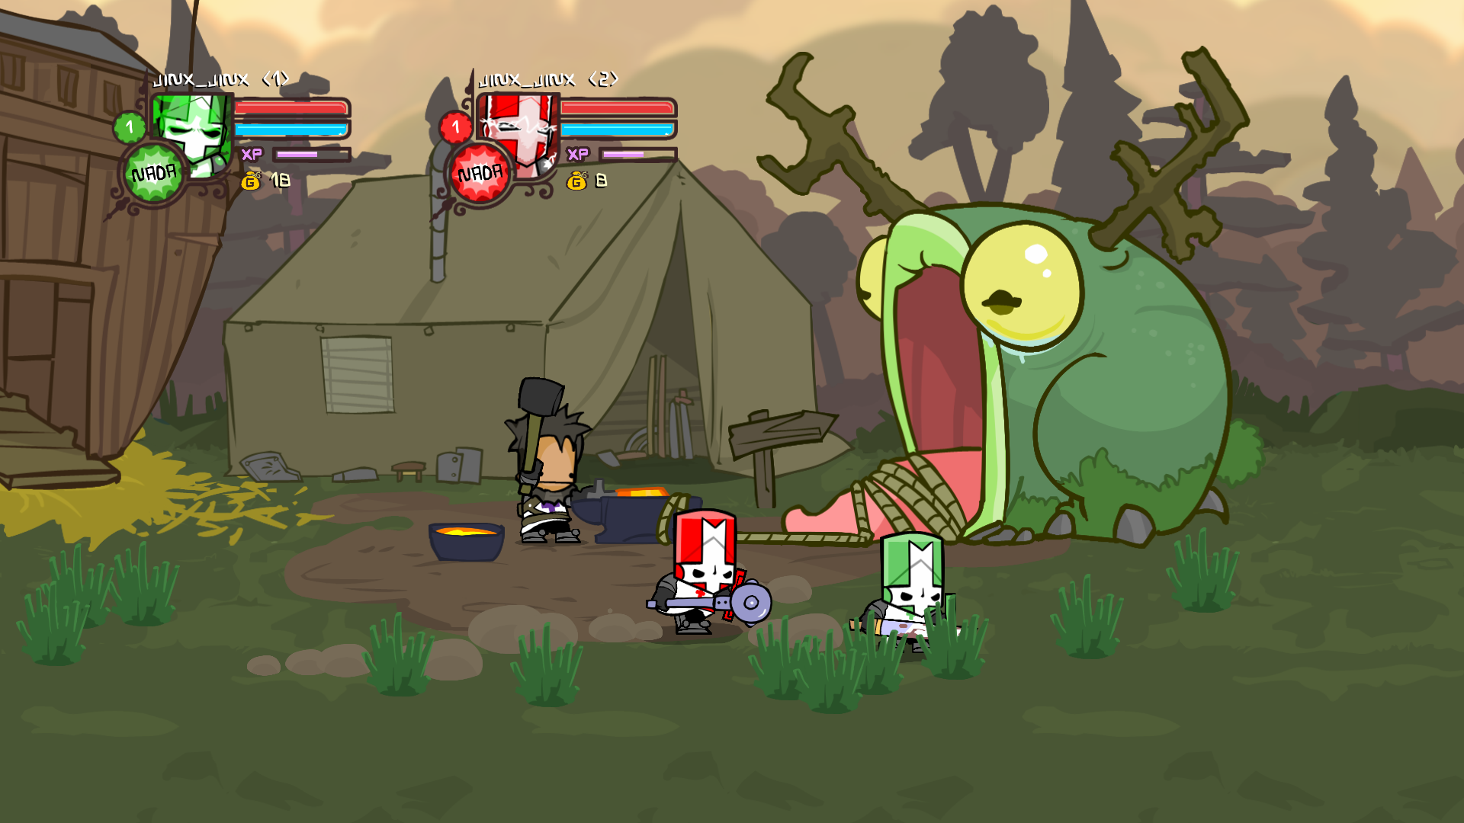
References (How I came to the concept)
Construction skill van Runescape… yep
Iedere mobile game ever,
MAAR dit word dat dus totaal niet (hoop ik) als
het gekozen zou worden.
Sorry not sorry
Herinneringen naar Castle Crashers character

Slide 5
Concept 2 “My mine, our cavern”
2.5D
Time Trial based
Navigate through randomized mines
Randomized tier blocks (Regular, Regular + Gold, Gem Rocks)
Local Multiplayer
Hostile mobs
Randomized Levels w/ Themes
Random Minerals that need to be held (Not really collectable);
Shops OR create own items at randomized anvils (With random Minerals)
Goofy?

Slide 6
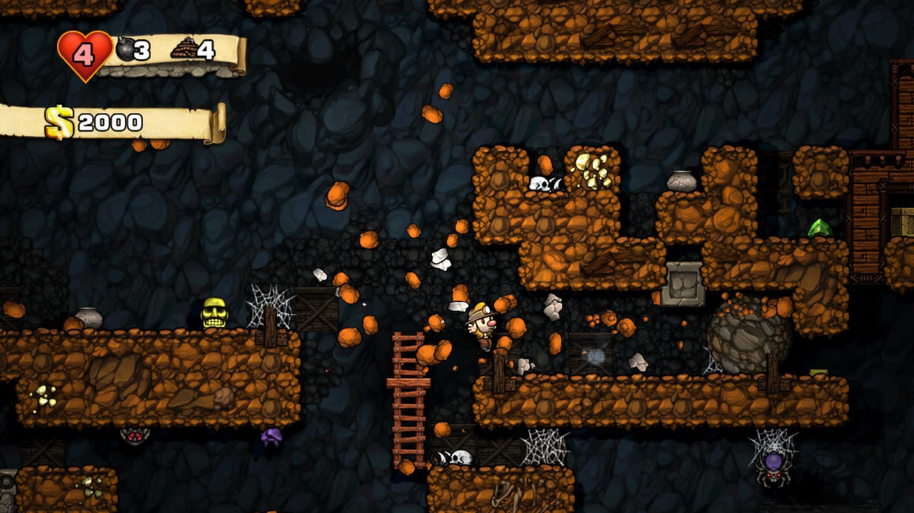
References
minecraft

Slide 7
Einde
Zijn er nog vragen?

